Slide 1
The rise of E-Sports
By: Chao Zhang, Adam Weston, Nick Quintela, Brandon Smith

Slide 2
Rationale
Group interest
Knowledge of topic
Technology related
Spread awareness about the growing community
Support electronic sports entertainment

Slide 3
Research
Three major events
How they helped the growth of E-Sports
Evolution Championship Series (Evo)
Major League Gaming (MLG)
League of Legends World Championship Series
Group roles
Barriers
Recommendations

Slide 4

Evolution Championship Series

Slide 5
Evolution Championship series
Annual event for arcade style fighting games
Original name was “Battle of the Bay” changed in 2002
Founded in Sunnyvale California in 1996 by Tom Cannon
Originally started playing Super Street Fighter 2 Turbo and Street Fighter Alpha 2
Moved to Las Vegas

Slide 6
Evolution Championship series
Started by using arcade machines, moved to consoles in 2004
The largest and longest fighting game event in the world
Started out as a small gathering of friends in an arcade
Since 2009 Evo has exploded in popularity, year after year breaking their previously set records

Slide 7
Evolution Championship series
With only 2400 competitors the 2011 it broke the record for the most viewed event in history at the time
Over 2 million unique viewers from all around the world
Viewers consumed over 1.9 million hours of video content with an average of 55 minutes per person
The finals became so popular that the finalists became four of the top 10 trending topics on Twitter

Slide 8
Evolution Championship series
Broke the record for the most competitors in a single event in competitive gaming and e-Sports history in 2013 with exactly 3,538 competitors
Grand total of 6,097 entries across 51 countries
Over the 3 day event 30,485+ matches were played
With the growth in the community Evo has now started raising money for charities, making a total of $225,744 in 2013

Slide 9
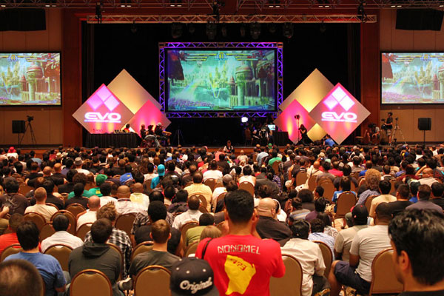
Evolution Championship series
http://www.youtube.com/watch?v=wZTWXaLD274
  10:25

Slide 10

Major League Gaming

Slide 11
Major League Gaming
MLG is the medium for games that are most popular in the e-Sports scene
Host to a significant amount of tournaments from some of the most competitive games to date:
  Super Smash Bros. Melee
  Halo 2, Halo 3
  Call of Duty
  World of Warcraft
  Starcraft 2
  League of Legends

Slide 12
Major League Gaming
Founded in 2002 by Sundance DiGiovanni and Mike Sepso
Aim is to elevate computer and console game tournaments to viable competitive and spectator events
MLG became the first televised console gaming league in the United States, with their Halo 2 Pro Series being broadcast in 2006

Slide 13
Major League Gaming
Spike in popularity that came about from streaming services over the internet
Release of MLG.tv increased immense numbers in regards to viewing
Streamed more than 1.3 petabytes
Previous ties to ESPN, E-Sports viewing needed to be taken into the more free market of the internet
Already surpassed some of the most popular sports leagues in America such as the NFL and NBA

Slide 14
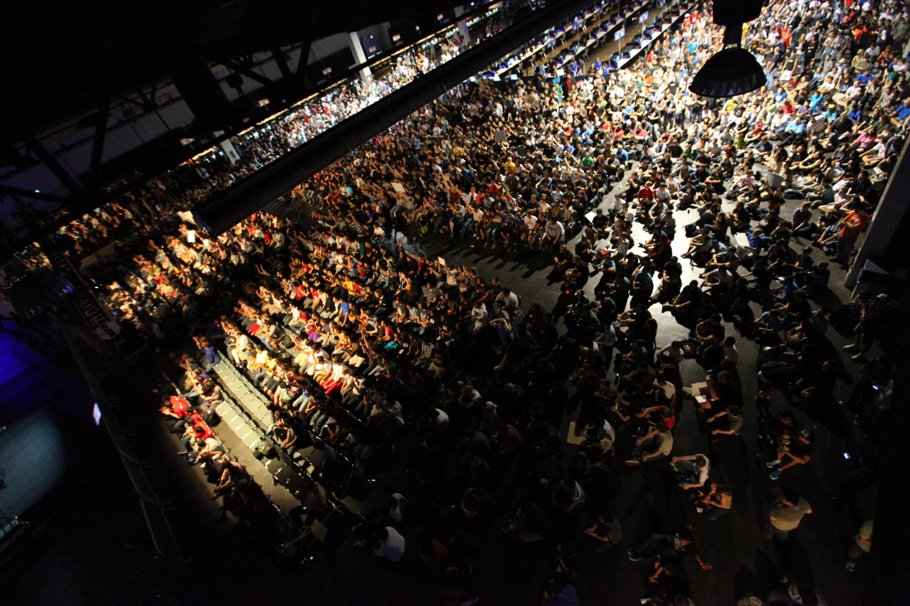
Major League Gaming
http://www.youtube.com/watch?v=7yLDq6hCfOc

Slide 15

League of Legends
World Championship Series

Slide 16
League of Legends
World Championship Series
League of Legends
Developed and published by Riot Games
Co-founded by Brandon Beck and Marc Merrill
Released on October 27, 2009
Most played PC game in the world

Slide 17
League of Legends
World Championship Series
Awards
  IGN PC Best Strategy Game 2009
    Readers’ Choice
  Gamespy Gamers' Choice Awards 2009
    PC Gamers’ Choice
  1st Game Developers Online Choice Awards
    Best Online Technology, Visual Arts, Game Design, New Online Game, Audience Award
  Golden Joystick Award 2010
    Online Game Of The Year
  Golden Joystick Award 2011
    Best Free-To-Play Game

Slide 18
League of Legends
World Championship Series
League of Legends started Season 1 of its competitive season in 2010
competitive seasons end with a tournament where the top teams in the world would face off and compete for prize money
Many of the players involved are pursuing League of Legends E-Sports as a career

Slide 19
League of Legends
World Championship Series
With success in each season, the number of tournament circuits for League of Legends has grown each year
Official tournament hosted by Riot Games

Slide 20
League of Legends
World Championship Series
The Season 1 World Championships held at DreamHack in Sweden in 2011
Over 1.6 million viewers watched live streaming broadcast of the event
Peak of over 210,000 simultaneous viewers in one semi-final match
Venue hosted 200 live audience members
$100,000 total prize winnings, $50,000 to winner

Slide 21
League of Legends
World Championship Series
Season 2 World Championships held in downtown Los Angeles in 2012
Finals hosted in the gym of University of Southern California
Peak of 1 million streaming viewers online simultaneously
7000 live audience members
$2,000,000 total prize winnings, $1,000,000 to winner

Slide 22
League of Legends
World Championship Series
Season 3 Championships tournament held in the Staples Center in Los Angeles in 2013
Biggest venue in E-Sports history
Total of 32 million viewers with a peak of 8.5 million viewers simultaneously
Held a live audience of 11,000 members
$2,050,000 total prize winnings, $1,000,000 to winner

Slide 23
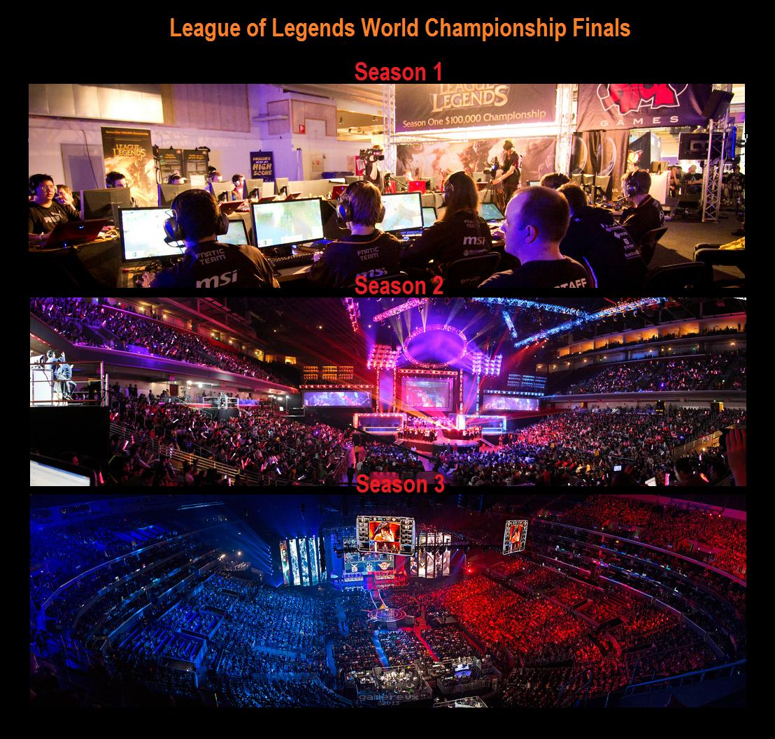
League of Legends
World Championship Series
http://www.youtube.com/watch?v=wp8FUlAtfko

Slide 24
Conclusions
E-Sports is growing in popular due to the progression of technology and the internet
E-Sports is worth being categorized as competitive sports due to the millions of fans supporting it
E-Sports is still continuing to grow with the support of increasing sponsors it will continue to prosper in today’s society

